Slide 1
Web fundamentals
checkpoint

Slide 2
Objective :
How does the web work?
What do you need to be a web developer?
What is the role of a web developer.

Slide 3
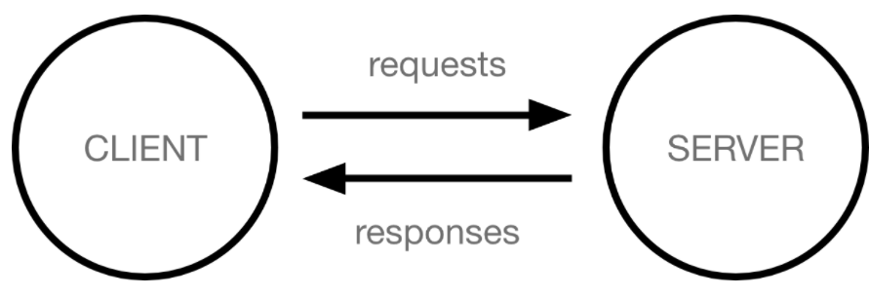
How does the web work?
When you type a web address into your browser :
1/ The browser goes to the DNS server, and finds the real address of the server that the website lives on.
2/ The browser sends an HTTP request message to the server, asking it to send a copy of the website to the client . This message, and all other data sent between the client and the server, is sent across your internet connection using TCP/IP.
3/ If the server approves the client's request, the server sends the client a message, that allow him to look at the website, and then starts sending the website's files to the browser as a series of small chunks called data packets .
4/ The browser assembles the small chunks into a complete web page and displays it to you .

Slide 4
What do you need to be a web developer?
Before you can call yourself a web developer and start applying for jobs, you’ll need to master HTML, CSS and JavaScript .
It’s impossible to go into a career in web development if you’re not fluent in these three core languages. HTML is the language used to create websites and apps; you’ll use it to describe the structure of the page. CSS is used to describe the visual presentation of these pages, determining things like layout, colors and fonts . JavaScript is used to make these pages interactive. And these aren’t the only programming languages .

Slide 5
What is the role of a web developer ?
Web developers are responsible for building a product that meets both the client’s needs and those of the customer or end user. Web developers collaborate with stakeholders, clients and designers in order to understand the vision: how should the final website look and function?
A large part of web development also revolves around identifying and fixing bugs in order to constantly optimize and improve a website or system. Web developers are therefore keen problem solvers, regularly coming up with solutions and workarounds to keep things running smoothly.

